Slide 1
Lossless Decomposition
Anannya Sengupta
CS 157A
Prof. Sin-Min Lee

Slide 2
Definition of Decomposition
Let R be a relation schema
A set of relation schemas { R1, R2,…, Rn } is a decomposition of R if
R = R1 U R2 U …..U Rn
each Ri is a subset of R ( for i = 1,2…,n)

Slide 3
Example of Decomposition
For relation R(x,y,z) there can be 2 subsets:
R1(x,z) and R2(y,z)
If we union R1 and R2, we get R
R = R1 U R2

Slide 4
Goal of Decomposition
Eliminate redundancy by decomposing a relation into several relations in a higher normal form.
It is important to check that a decomposition does not lead to bad design

Slide 5
Problem with Decomposition
Given instances of the decomposed relations, we may not be able to reconstruct the corresponding instance of the original relation – information loss

Slide 6
Example : Problem with Decomposition
R
Model Name | Price | Category
a11 | 100 | Canon
s20 | 200 | Nikon
a70 | 150 | Canon
R1
R2
Model Name | Category
a11 | Canon
s20 | Nikon
a70 | Canon
Price | Category
100 | Canon
200 | Nikon
150 | Canon

Slide 7
Example : Problem with Decomposition
R1 U R2
Model Name | Price | Category
a11 | 100 | Canon
a11 | 150 | Canon
s20 | 200 | Nikon
a70 | 100 | Canon
a70 | 150 | Canon
R
Model Name | Price | Category
a11 | 100 | Canon
s20 | 200 | Nikon
a70 | 150 | Canon

Slide 8
Lossy decomposition
In previous example, additional tuples are obtained along with original tuples
Although there are more tuples, this leads to less information
Due to the loss of information, decomposition for previous example is called lossy decomposition or lossy-join decomposition

Slide 9
Lossy decomposition (more example)
T
Employee | Project | Branch
Brown | Mars | L.A.
Green | Jupiter | San Jose
Green | Venus | San Jose
Hoskins | Saturn | San Jose
Hoskins | Venus | San Jose
Functional dependencies:
Employee Branch, Project Branch

Slide 10
Lossy decomposition
Decomposition of the previous relation
T1
T2
Employee | Branch
Brown | L.A
Green | San Jose
Hoskins | San Jose
Project | Branch
Mars | L.A.
Jupiter | San Jose
Saturn | San Jose
Venus | San Jose

Slide 11
Lossy decomposition
After Natural Join
Original Relation
Employee | Project | Branch
Brown | Mars | L.A.
Green | Jupiter | San Jose
Green | Venus | San Jose
Hoskins | Saturn | San Jose
Hoskins | Venus | San Jose
Green | Saturn | San Jose
Hoskins | Jupiter | San Jose
Employee | Project | Branch
Brown | Mars | L.A.
Green | Jupiter | San Jose
Green | Venus | San Jose
Hoskins | Saturn | San Jose
Hoskins | Venus | San Jose
After Natural Join, we get two extra tuples. Thus, there is loss of information.

Slide 12
Lossless Decomposition
A decomposition {R1, R2,…, Rn} of a relation R is called a lossless decomposition for R if the natural join of R1, R2,…, Rn produces exactly the relation R.

Slide 13
Lossless Decomposition
A decomposition is lossless if we can recover:
R(A, B, C)
Decompose
R1(A, B) R2(A, C)
Recover
R’(A, B, C)
Thus, R’ = R

Slide 14
Lossless Decomposition Property
R : relation
F : set of functional dependencies on R
X,Y : decomposition of R
Decomposition is lossles if :
  X ∩ Y → X, that is: all attributes common to both X and Y functionally determine ALL the attributes in X OR
  X ∩ Y → Y, that is: all attributes common to both X and Y functionally determine ALL the attributes in Y

Slide 15
Lossless Decomposition Property
In other words, if X ∩ Y forms a superkey of either X or Y, the decomposition of R is a lossless decomposition

Slide 16
Armstrong’s Axioms
X, Y, Z are sets of attributes
Reflexivity: If X ⊇ Y, then X → Y
Augmentation: If X → Y, then XZ → YZ for any Z
Transitivity: If X → Y and Y → Z, then
X → Z
Union: If X → Y and X → Z, then X → YZ
Decomposition: If X → YZ, then X → Y and
X → Z

Slide 17
Example : Lossless Decomposition
Given:
Lending-schema = (branch-name, branch-city, assets, customer-name, loan-number, amount)
Required FD’s:
branch-name branch-city assets
loan-number amount branch-name
Decompose Lending-schema into two schemas:
Branch-schema = (branch-name, branch-city, assets)
Loan-info-schema = (branch-name, customer-name, loan-number, amount)

Slide 18
Example : Lossless Decomposition
Show that decomposition is Lossless Decomposition
Since branch-name branch-city assets, the augmentation rule for FD implies that:
branch-name branch-name branch-city assets
Since Branch-schema ∩ Loan-info-schema = {branch-name}
Thus, this decomposition is Lossless decomposition

Slide 19
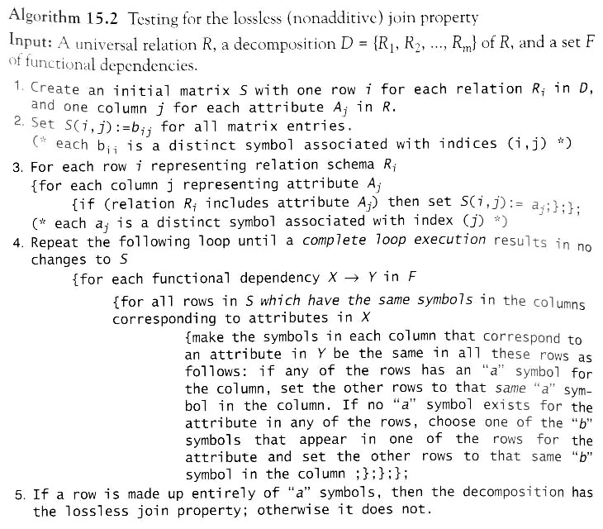

Slide 20
Example
R1 (A1, A2, A3, A5)
R2 (A1, A3, A4)
R3 (A4, A5)
FD1: A1 → A3 A5
FD2: A5 → A1 A4
FD3: A3 A4 → A2

Slide 21
Example (con’t)
A1 A2 A3 A4 A5
R1 a(1) a(2) a(3) b(1,4) a(5)
R2 a(1) b(2,2) a(3) a(4) b(2,5)
R3 b(3,1) b(3,2) b(3,3) a(4) a(5)

Slide 22
Example (con’t)
By FD1: A1 → A3 A5
A1 A2 A3 A4 A5
R1 a(1) a(2) a(3) b(1,4) a(5)
R2 a(1) b(2,2) a(3) a(4) b(2,5)
R3 b(3,1) b(3,2) b(3,3) a(4) a(5)

Slide 23
Example (con’t)
By FD1: A1 → A3 A5
we have a new result table
A1 A2 A3 A4 A5
R1 a(1) a(2) a(3) b(1,4) a(5)
R2 a(1) b(2,2) a(3) a(4) a(5)
R3 b(3,1) b(3,2) b(3,3) a(4) a(5)

Slide 24
Example (con’t)
By FD2: A5 → A1 A4
A1 A2 A3 A4 A5
R1 a(1) a(2) a(3) b(1,4) a(5)
R2 a(1) b(2,2) a(3) a(4) a(5)
R3 b(3,1) b(3,2) b(3,3) a(4) a(5)

Slide 25
Example (con’t)
FD2: A5 → A1 A4
we have a new result table
A1 A2 A3 A4 A5
R1 a(1) a(2) a(3) a(4) a(5)
R2 a(1) b(2,2) a(3) a(4) a(5)
R3 a(1) b(3,2) b(3,3) a(4) a(5)

Slide 26
Conclusions
Decompositions should always be lossless
Lossless decomposition ensure that the information in the original relation can be accurately reconstructed based on the information represented in the decomposed relations.

Slide 27
References
Fundamentals of Database Systems Fourth Edition Elmasri, Navathe
Database System Concepts Fourth Edition Silberschatz, Korth, Sudarshan

